Slide 1
Drone Project
Krish Kabra & Stefan Orosco

Slide 2
Introduction

Slide 3
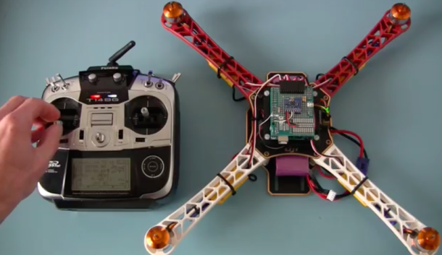
DIY Quadcopter Drone
Main
Arduino-based Quadcopter Drone
Radio-Frequency Control
PID Stabilization System
Secondary
Sonar-based Collision Avoidance
Possible Voice Control
Notes:
Image from: http://itersnews.com/?p=102155

Slide 4
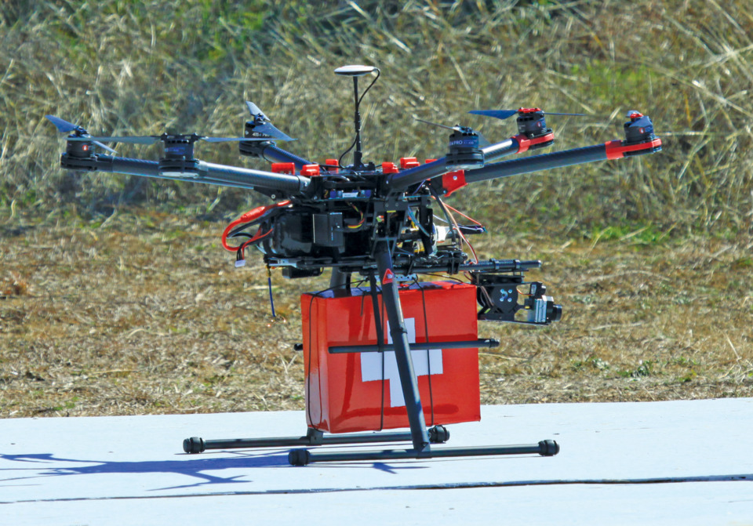
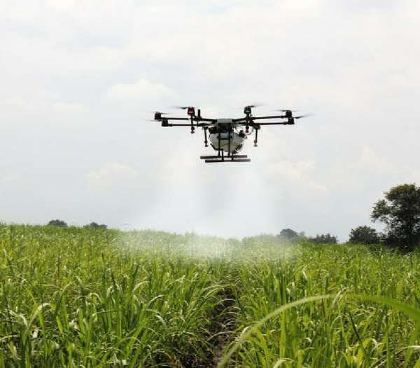
Applications
Autonomous Quadcopter Utilization
Search and Rescue Applications.
Agriculture: Mapping and Irrigation.
Entertainment: Selfie cameras, Cinema tracking cameras
Defense: Autonomous Robotic Police Force, Scouting, faster supply drops

Slide 5
Design

Slide 6
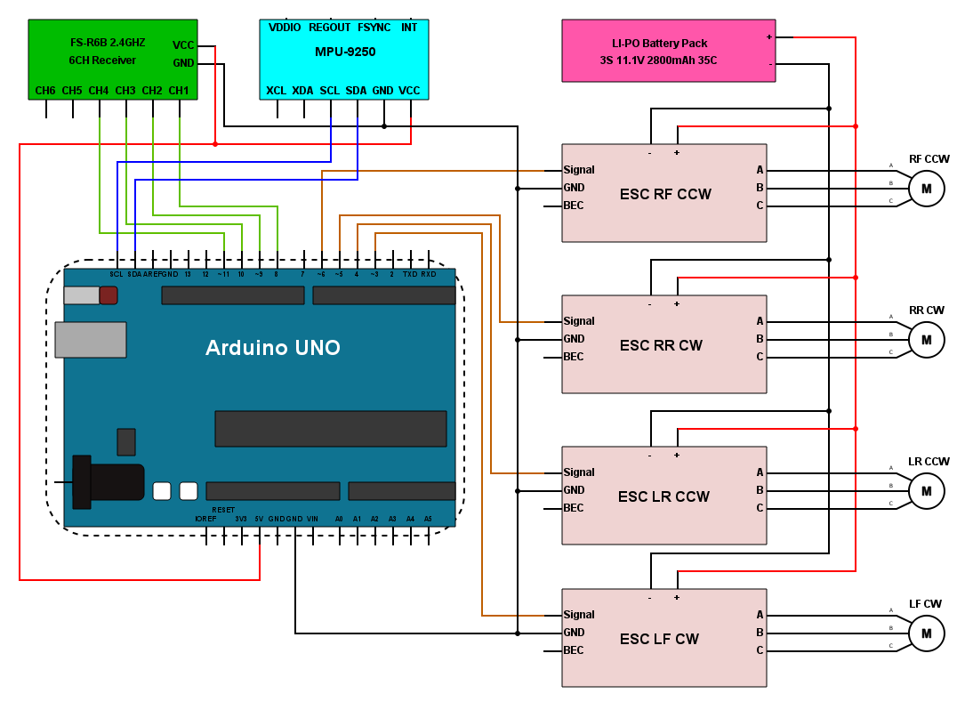
Schematic

Slide 7
Battery Control Circuit
Analog in
R1
R2
Circuit made to provide power to the Arduino and give indication of battery life for the quadcopter.
Vin
R2
R2
Analog in
Arduino Vin

Slide 8
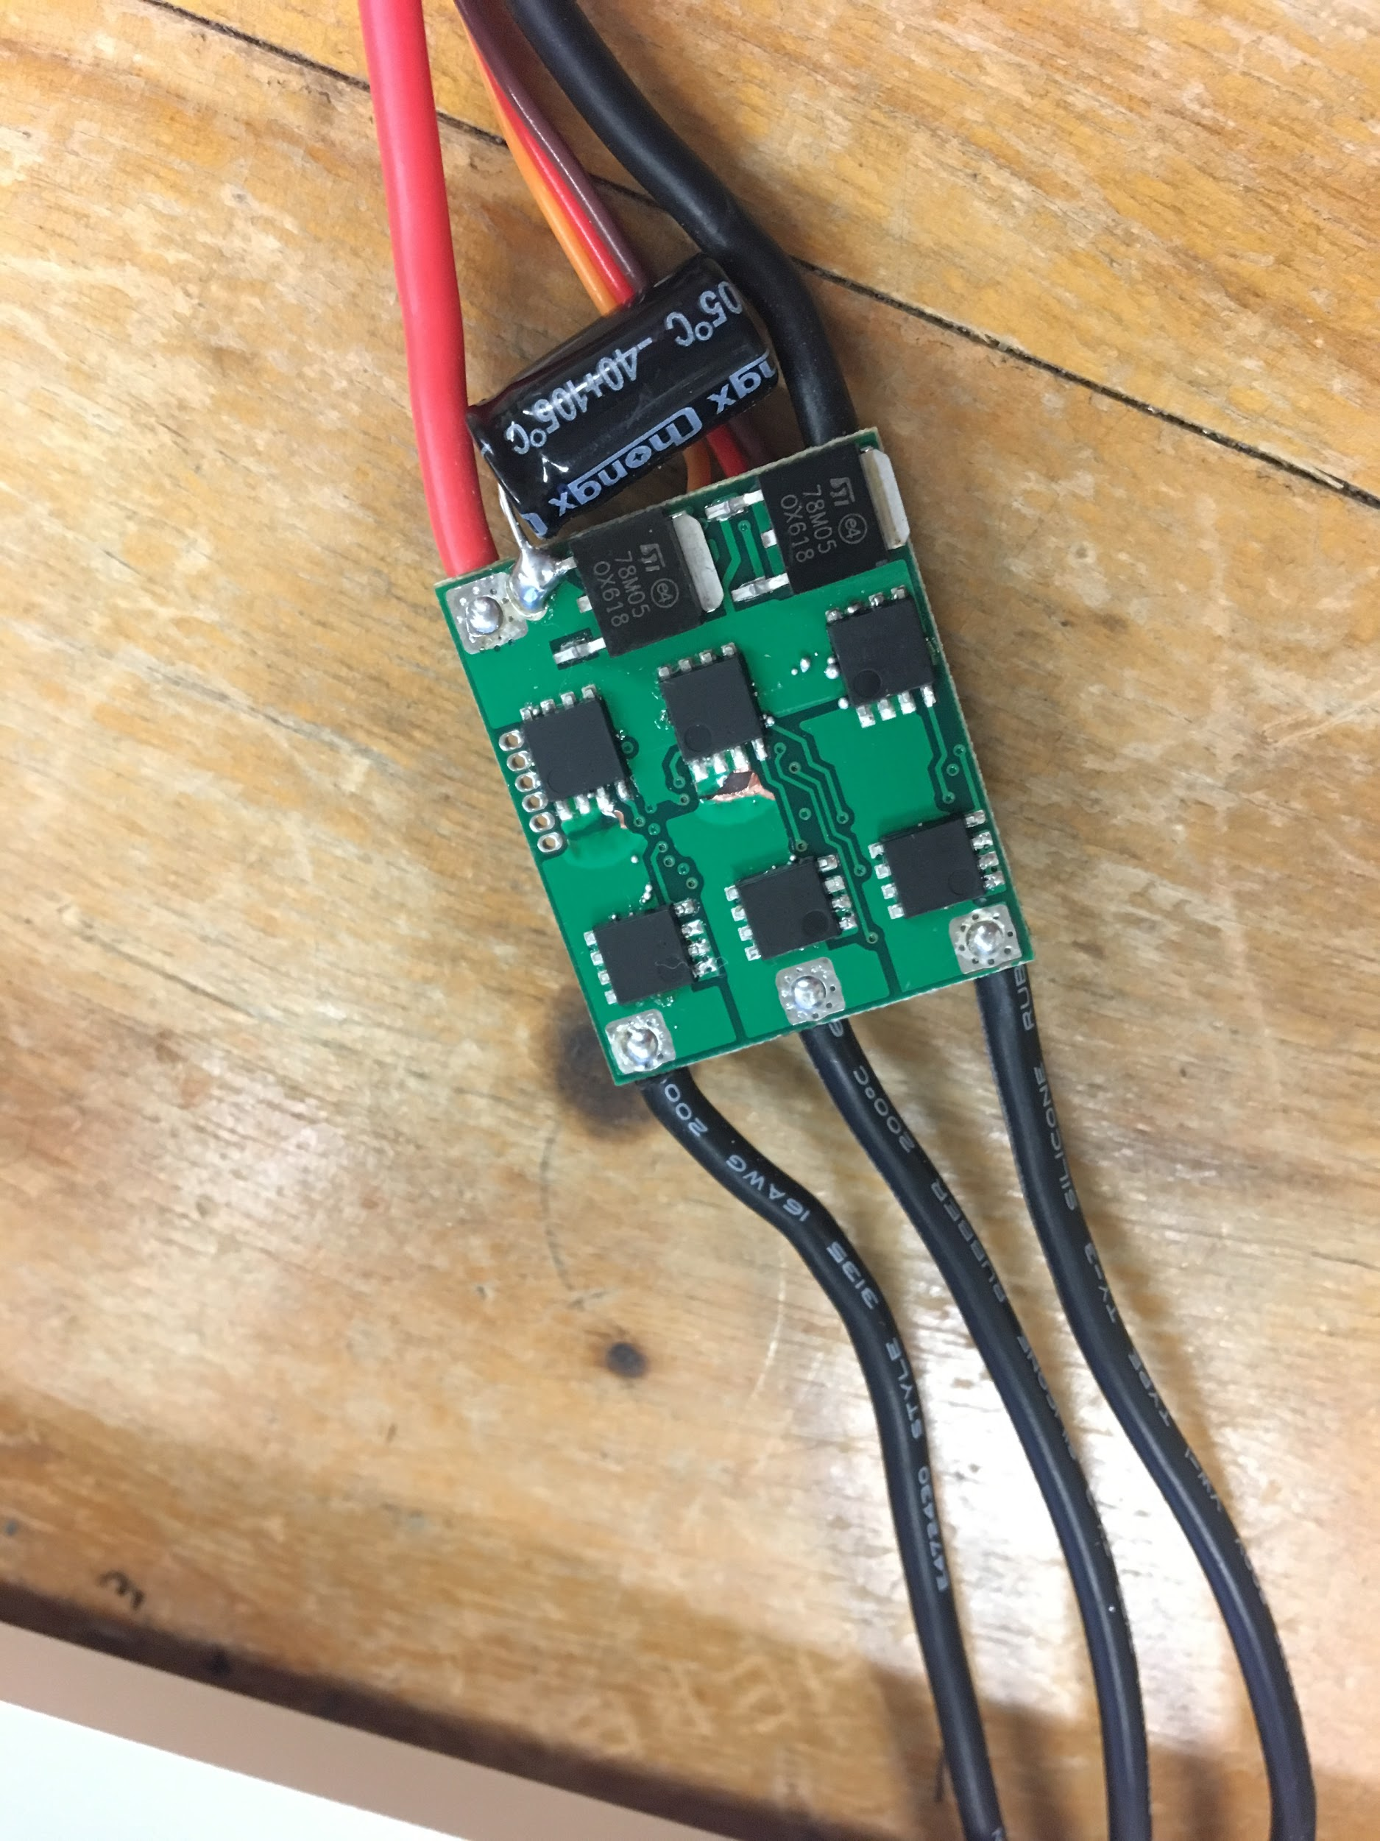
Motors and Electronic Speed Controllers (ESCs)
Brushless Motor - Internal magnet rotated by the induced alternating magnetic field from wire loops. ESC used to output A-B-C pulses at frequency which matches desired speed
ESC - middle top MOSFET chip has a visible short on the bottom three pins.
Notes:
Image from: https://www.youtube.com/watch?v=ZAY5JInyHXY

Slide 9
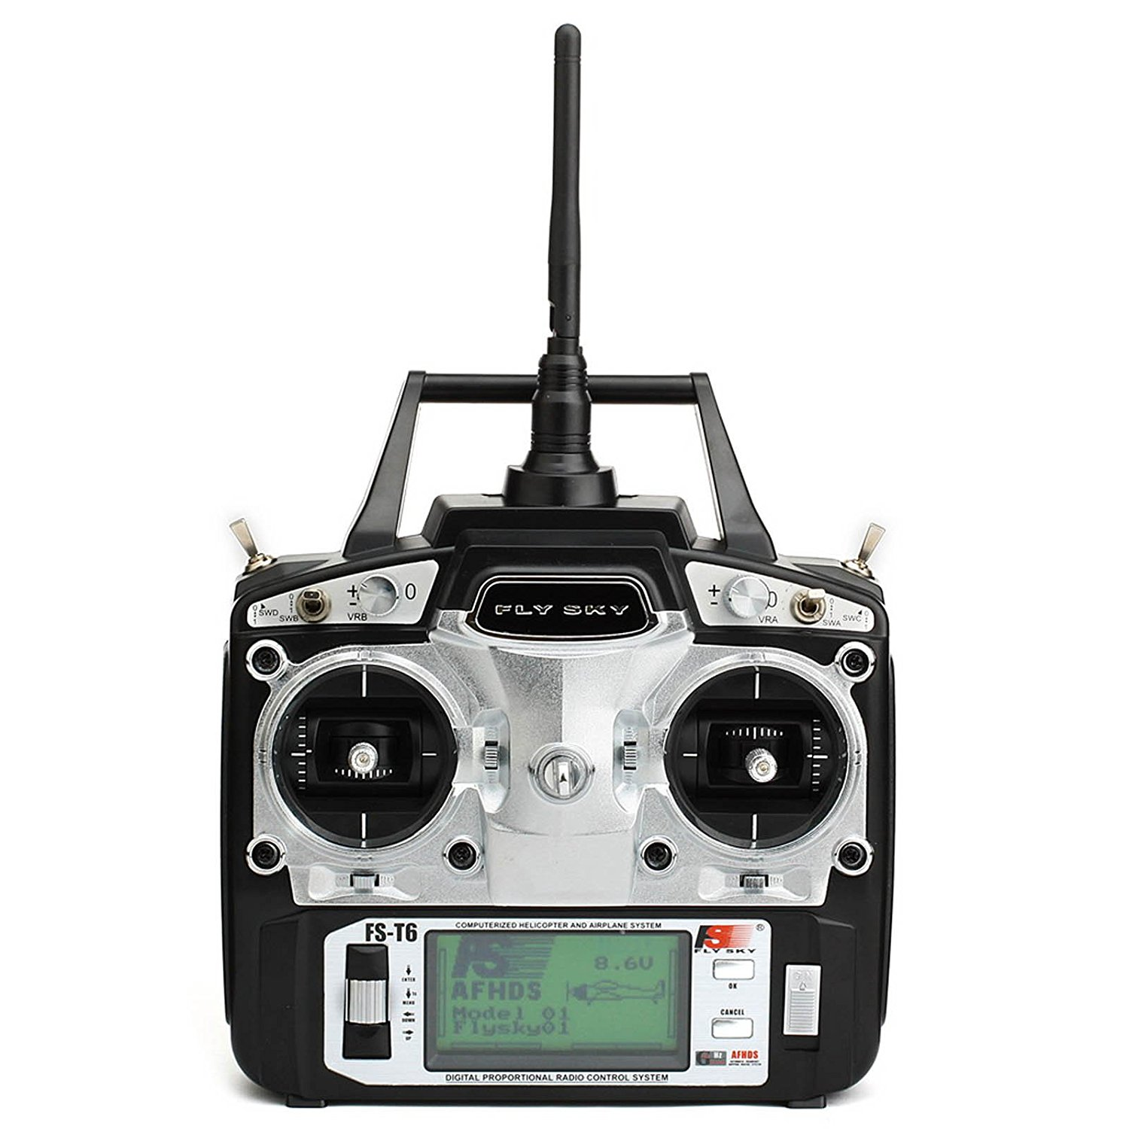
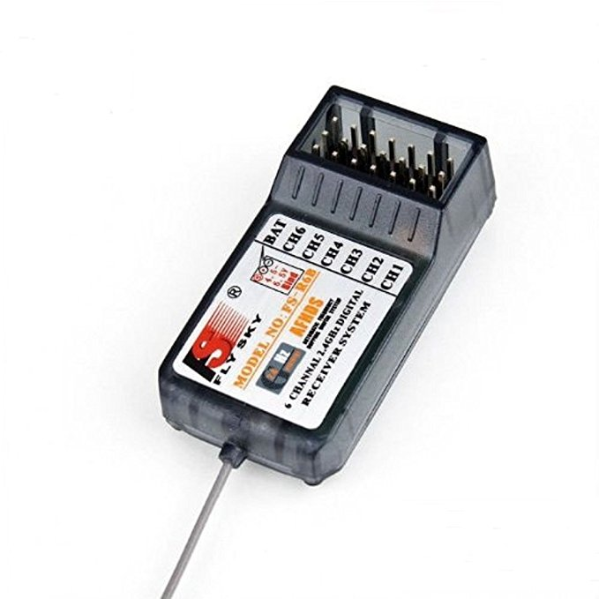
Radio Transmitter and Receiver
FlySky 2.4Ghz 6CH Transmitter
FlySky 2.4Ghz 6CH receiver

Slide 10
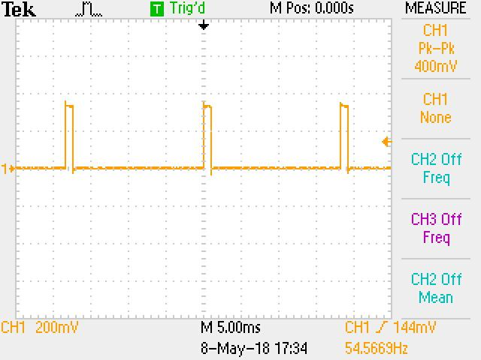
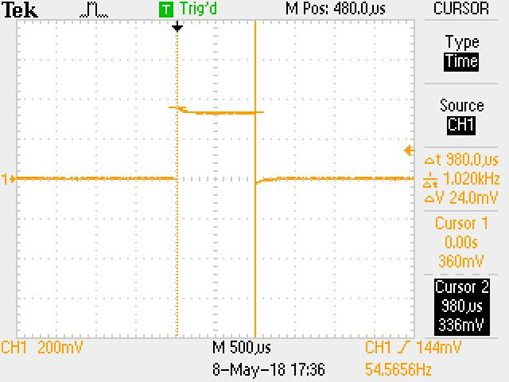
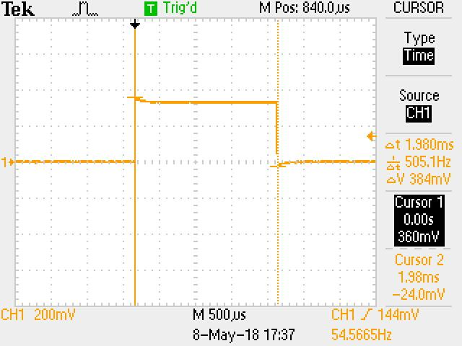
Receiver Output
Example output from receiver channel 3, which corresponds to the transmitter’s throttle
Left: we can pulses of constant time and frequency being received from the radio transmitter.
Middle: the pulse length for 0% throttle corresponds to approximately 1000us.
Right: the pulse length for 100% throttle corresponds to approximately 2000us.

Slide 11
Arduino - Motor control
Interrupt sequence for collecting receiver pulse duration (repeated for channels 2-4)
Function outputting PWM to ESCs

Slide 12
Motor Control Demo

Slide 13
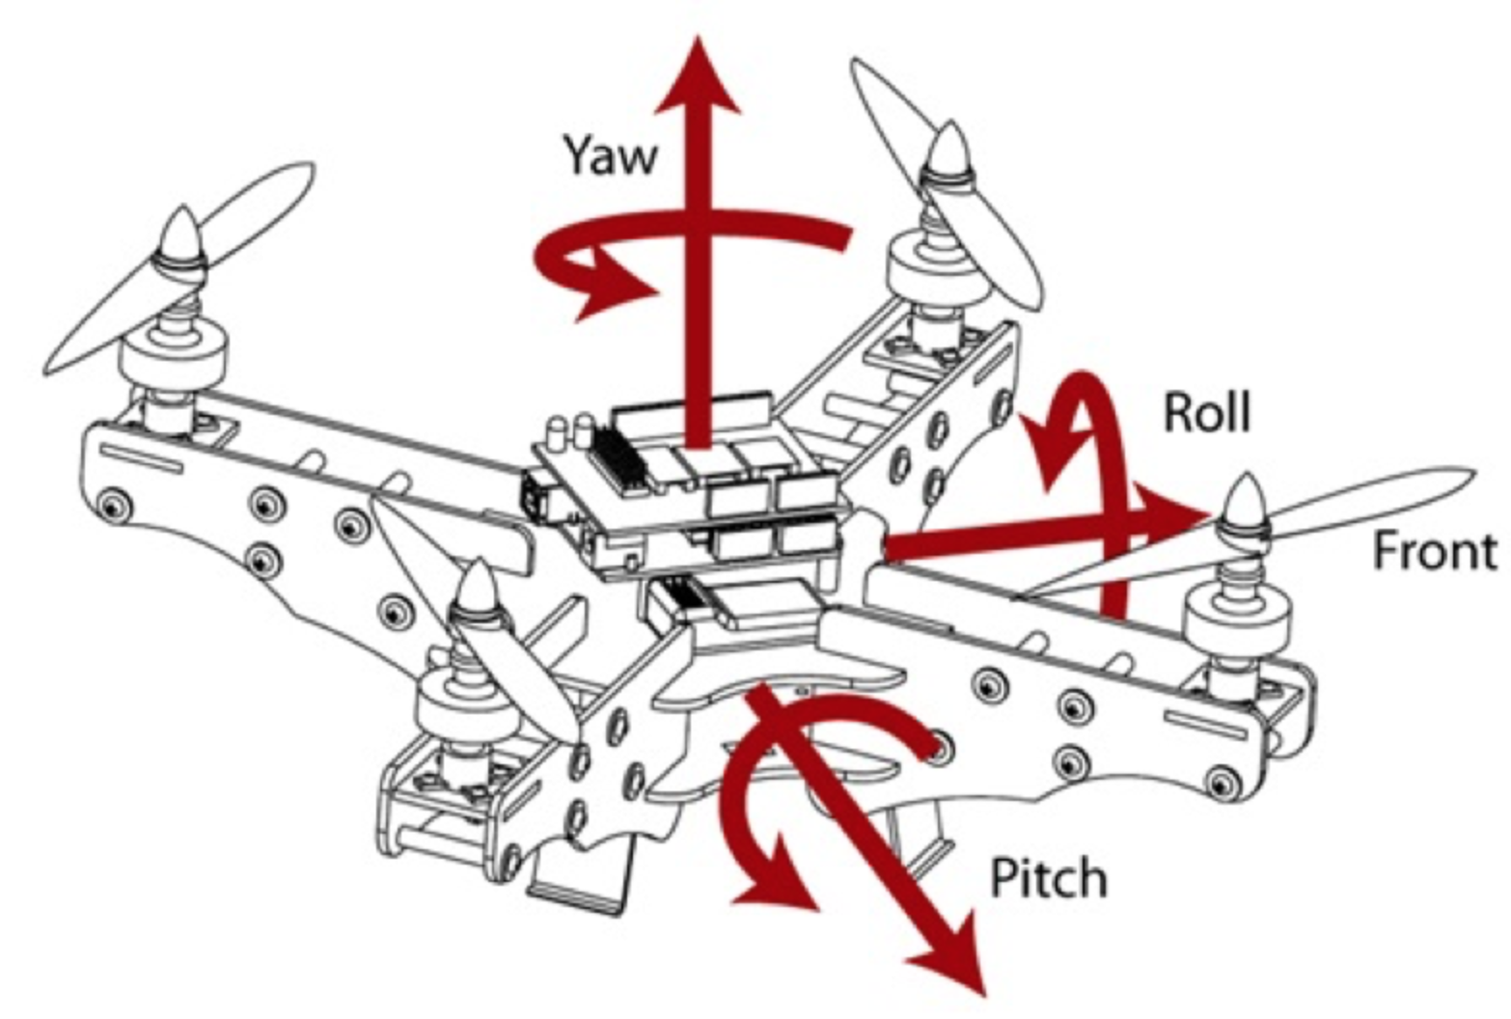
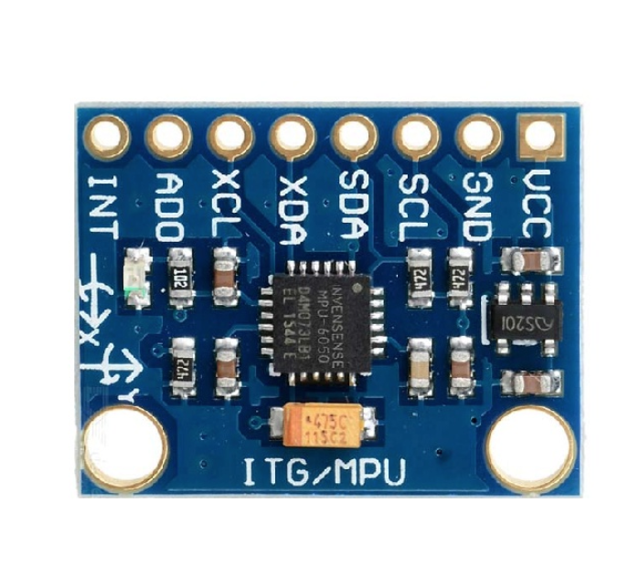
Internal Measurement Unit
How does the Quadcopter know which direction it is moving.
Two components to the IMU used in our quadcopter Gyro: measures angle rotation by summing these values you can get a measured angle.(drift and rotated reference frame Accelerometer: Measures the force relative to each axis (measured in g’s)
In perfect world only the Accelerometer values would be needed, however the constant vibrations make this impossible.
Final IMU utilizes small angle correction from the accelerometer and the bulk of the present angle comes from the gyro.

Slide 14
Arduino - Angle Calculations

Slide 15
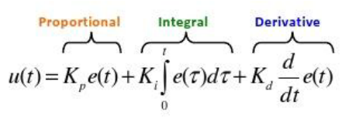
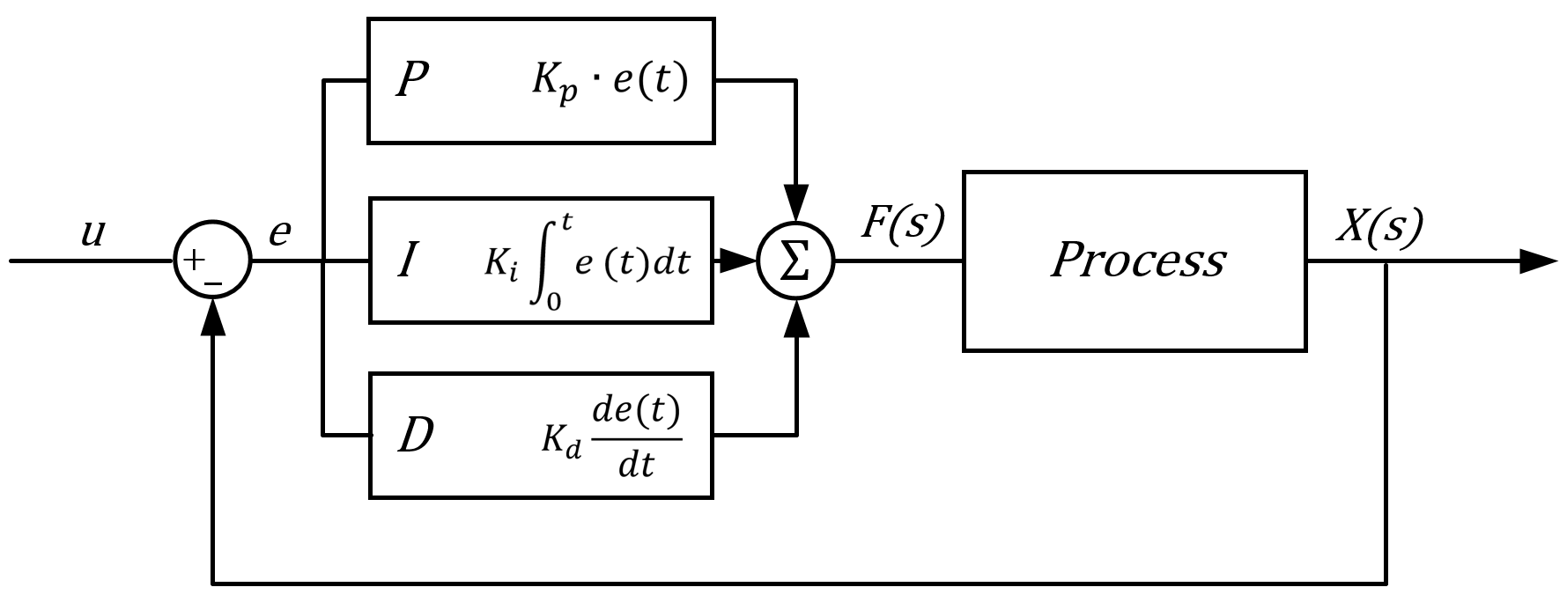
Flight Controller & PID
Flight Controller
Motors
How does a quadcopter fly?
How do we change pitch, roll and yaw?
PID Stabilization
Notes:
PID Equation Link: https://www.researchgate.net/profile/Vishnu_Divakar/publication/281746636/figure/fig4/AS:284649973665803@1444877250888/PID-Equation.png
PID Block Diagram: https://www.dewesoft.com/assets/img/pro/uploads/PIDfront.PNG

Slide 16
Arduino - PID Calculation & ESC output
Example PID calculation for roll. Similar procedure repeated for pitch and yaw angles
Calculated ESC output using PID corrections

Slide 17
Flight Controller Demo
(takes a little while to set up…)

Slide 18
Conclusion

Slide 19
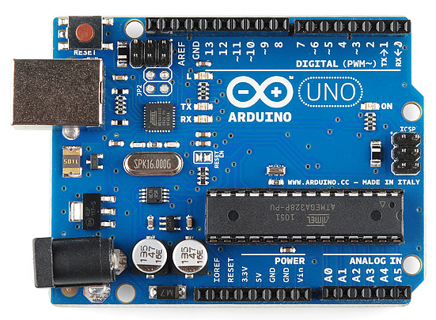
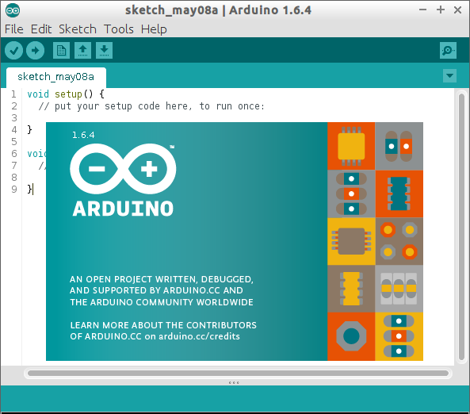
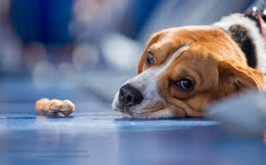
Problems and Solutions
Three Major Categories: Hardware, Software, Emotional

Slide 20
Hardware Issues
Bad Electronic Speed Controller Created Bad Motors and Delayed Progress.
Poor Battery Specs, Ordered an 11.2V LiPo battery, but was really 12.9V.
Propellers, different companies have various requirements for each motor.

Slide 21
Software
Largest source of uncertainty as neither of us were proficient in programming for embedded systems before.
Learning how to utilize pin change interrupts to optimize the control flow.
Timing, how fast does the code need to run and how to optimize the code for space. (utilizing registers rather than using IDE built in functions)

Slide 22
Emotional
How to manage expectations and set feasible goals.

Slide 23
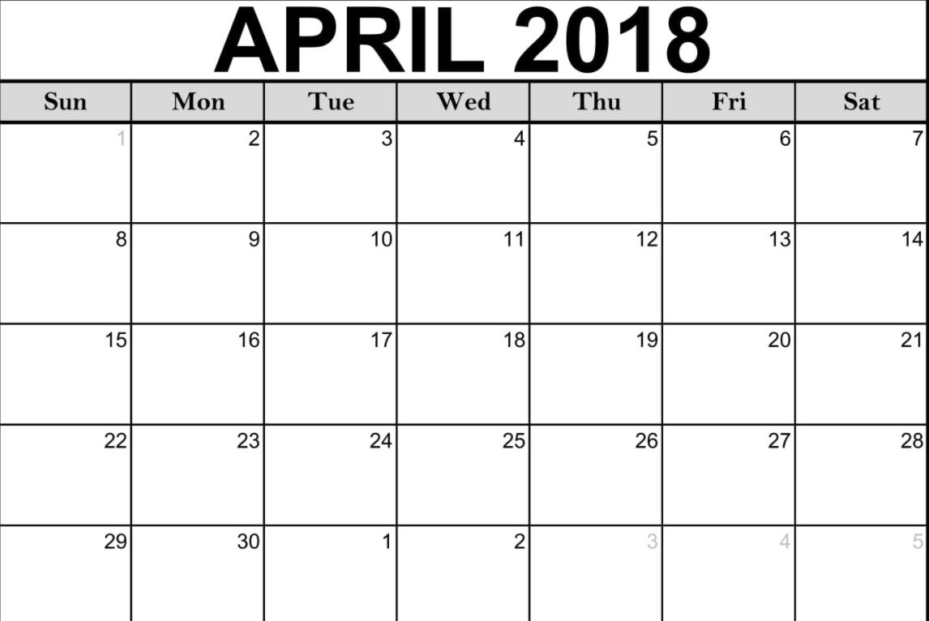
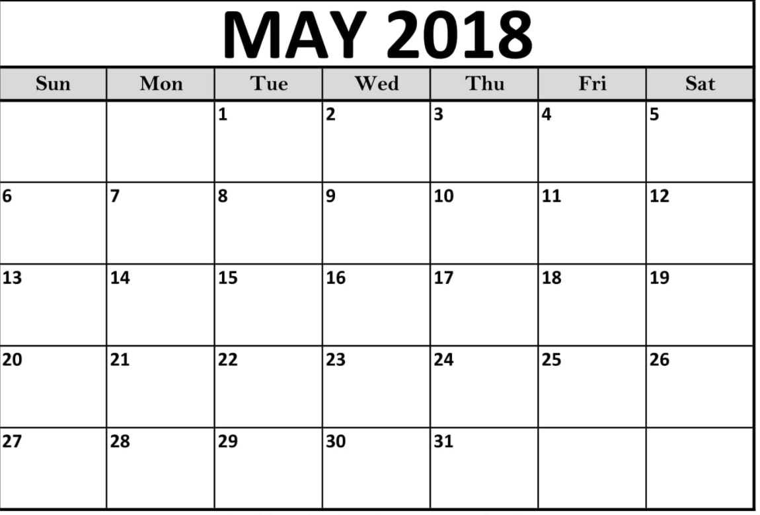
Timeline (initial)
Week 4- Outline Software (requirements and begin coding)
Week 5- Begin Physical Build (order back-up/misc. parts)
Week 6- Implement flight controller code onto ATmega 32 chip
; Continue coding PID control into motors
Week 7- Fine tuning of PID and first real world test flight
Week 8- Stress test stability of flight controller and increase robustness of design
Week 9- ** Implement guidance system controls **
Begin Build
Flight Controller Implementation
Finish PID Tuning
Block Out Software
Stress Test
Begin Build
Guidance System

Slide 24
Timeline (final)
Week 4- Outline Software (requirements and begin coding)
Week 5 - Drone Frame, motors and RF controller
Week 6- Finish transmitter/receiver & motor implementation
Week 7- IMU implementation
Week 8 - Flight controller and PID implementation
Week 9 - Preparing for final presentation
Major Hardware/Software issue
1 = motors & ESC break, 2 = wrong propellers
1
RF Transmitter/Receiver & Motors
IMU implementation
Block Out Software
Flight Controller & PID
2
Begin Build
Final presentation Prep
2

Slide 25
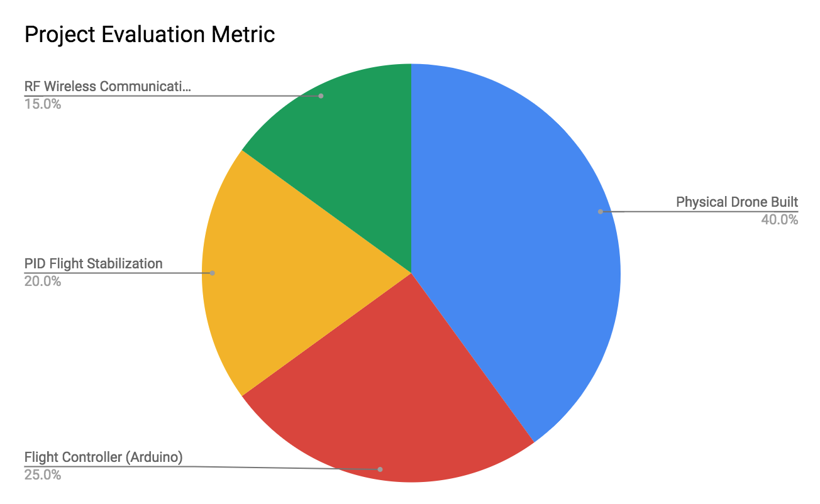
Project Evaluation Metric (initial)
No Real World Test
5%
Propellers
5%

Slide 26
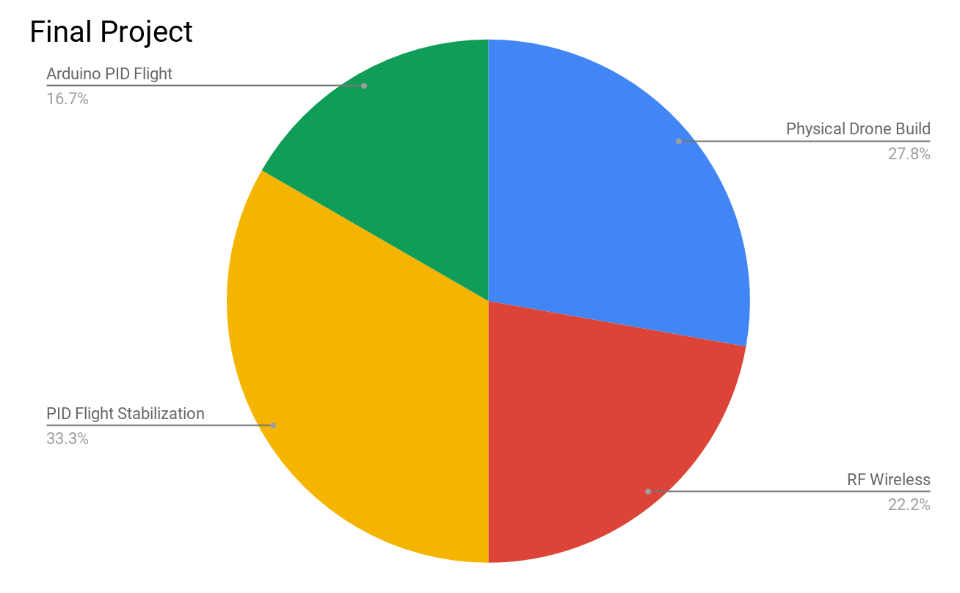
Project Evaluation Metric (final)

